Slide 1

SPADE for episodical food intakes
Estimating the habitual intake distribution of episodically consumed food(components)

Slide 2
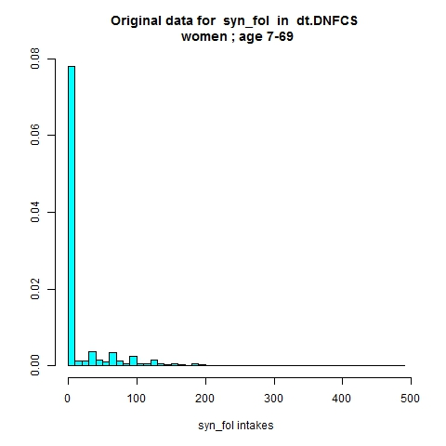
Let’s focus on a variable with many zero intakes: syn_fol (intake from food only)
Number of individuals with resp 0, 1, or 2 positive intakes
0 1 2
1294 355 259
Applying the original model for daily intakes won’t work: the large spike of zero intakes is troublesome.
There is no Box-Cox transformation that makes this (non-smooth) distribution approximately normal.
Introduction to SPADE part 2| VLAG, October 2021
Notes:
This is the output of a much earlier version of SPADE.RIVM, where it was possible to run a 1-part model to fit episodical intakes.

Slide 3
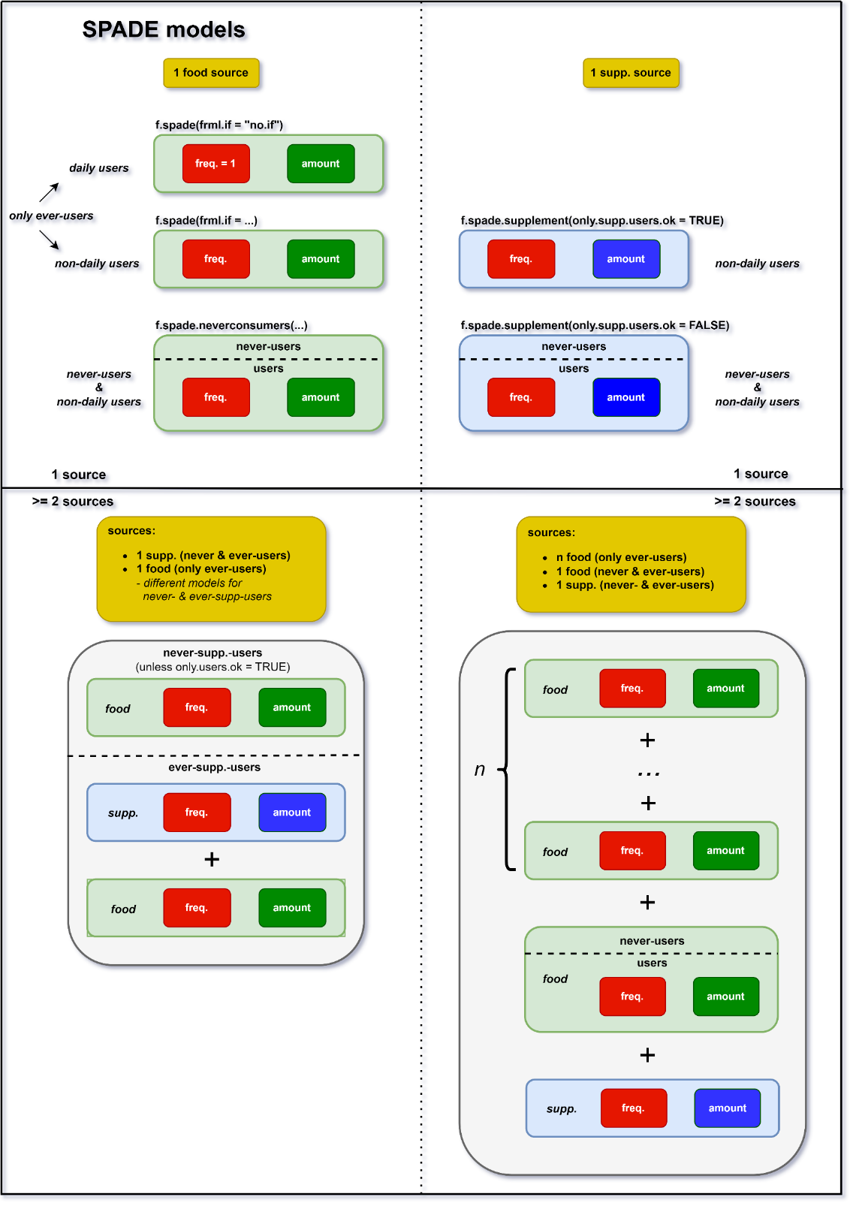

Slide 4


Slide 5
Evt model selection slide

Slide 6
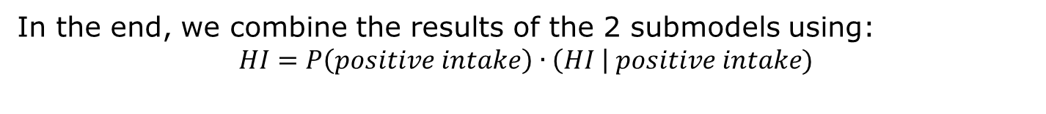
Split the data in two parts
*SPADE’s terminology: intake frequency = probability of positive intake frequency = 0: never consumed frequency = 0.5: consumed on 50% of day frequency = 1: consumed every day frequency > 1: impossible
(1) For every person:
No of Zeroes (e.g. 2)
No of positive intakes (e.g. 1) → use this to estimate the intake frequency distribution*
same model as for daily intakes
(2) Positive intake amounts → use this to model HI distribution conditional on having a positive intake
In the end, we combine the results of the 2 submodels using: $$HI=P\left(positive intake\right) \text{∙} \left(HI \right| positive intake)$$

Slide 7
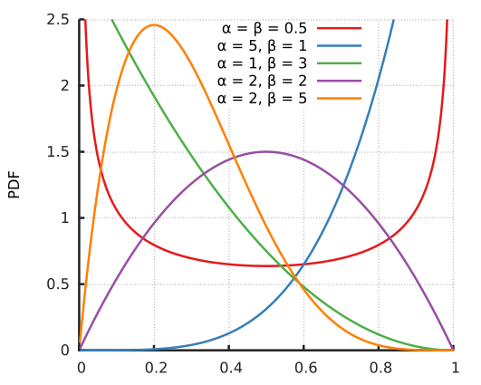
Distribution of intake frequencies
Data used: positive intake (yes / no)
Different persons can have different intake probabilities → SPADE finds a distribution of intake probabilities
Distribution used: Beta distribution
Mean of this distribution is modelled as a smooth function of age
source: https://en.wikipedia.org/wiki/Beta_distribution

Slide 8
Code to run a model for episodical intakes
fp = fractional polynomial
f.spade(frml.ia = syn_fol ~ fp(age),
frml.if = syn_fol ~ cs(age),
data = DNFCSmanual,
min.age = 7,
max.age = 69,
sex.label = "female",
seed = 29062025)
cs = smoothed cubic spline

Slide 9
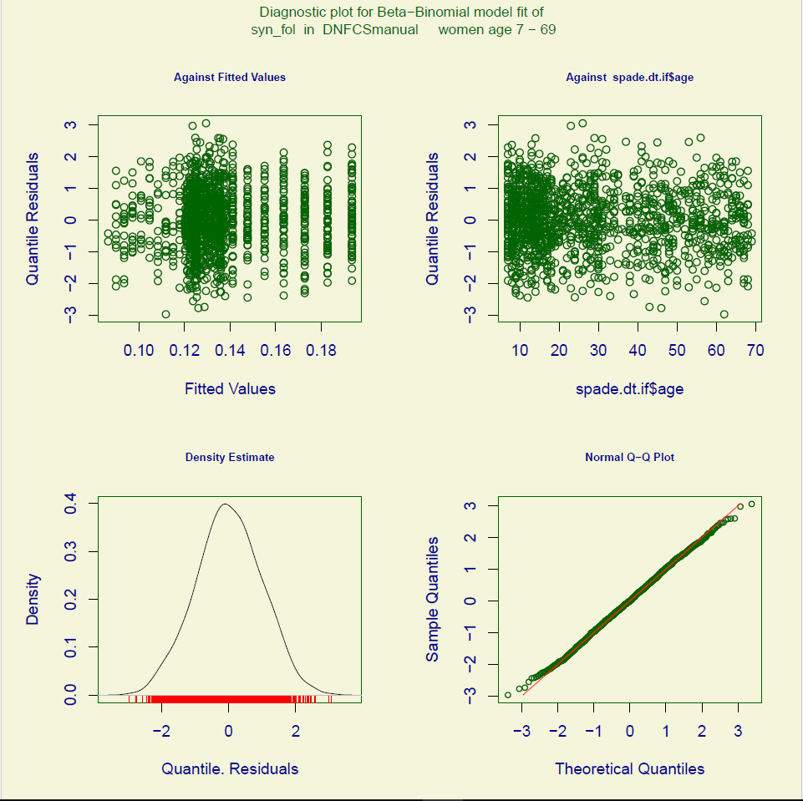
Diagnostics - intake frequency model
Plots to evaluate residuals of beta-binomial distribution for logistic model used in frequency modelling
In the left-hand upper plot the Quantile Residuals of the model are plotted against the fitted values, with the intention to check if there are some systematic abnormalities present
The right-hand upper plot shows again the Quantiles of the residuals plotted against age. There is no evidence for abnormalities
The left-hand lower plot shows the density of the Quantile Residuals and at the right-hand lower side the QQ-plots seems perfect

Slide 10
Diagnostics – intake frequency model
Numerical check of the rediduals, compare rResiduals with the theoretical values under theory (screenlogbook)
**************************************************************
Summary of the Randomised Quantile Residuals
check rResiduals theory
1 mean 0.01331821 0
2 variance 0.96169501 1
3 coef. of skewness -0.01652594 0
4 coef. of kurtosis 2.79826723 3
5 Filliben_correlation_coefficient 0.99957032 1**************************************************************

Slide 11
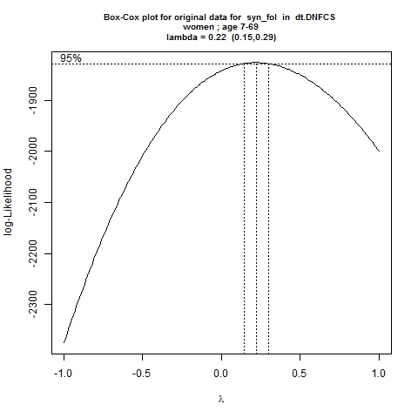
Diagnostics – intake amount model
Lambda = 0.22

Slide 12
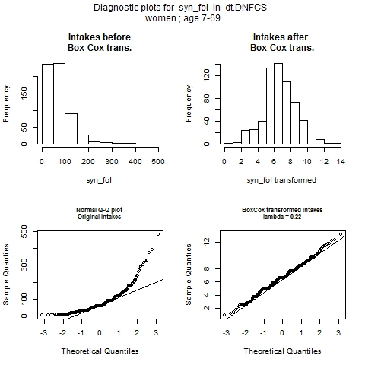
Diagnostics – intake amount model
Comparison between original data and transformed data
QQ-plot transformed data more or less straight line
Histogram more or less symmetrical

Slide 13
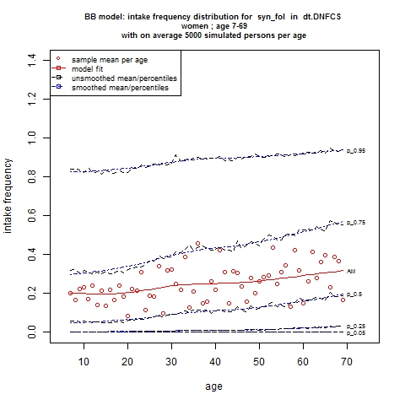
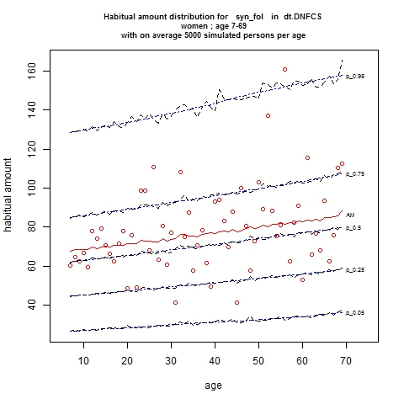
Intermediate results: freq & amounts
Intake frequency (left) and habitual intake amount (given consumption; right)

Slide 14
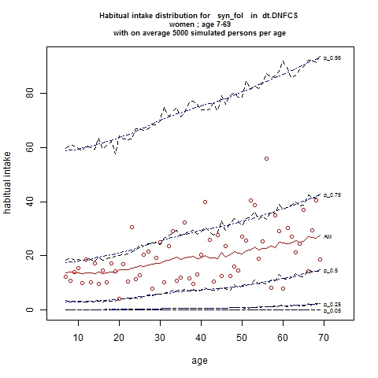
Final result: habitual intake distribution

Slide 15
How does current version of SPADE help you?

Slide 16
What if you use frml = “no.if” when you have zeroes in your data?
If < 5% of intakes is zero: SPADE increases all zero’s a little, to: 0.5 * minimum positive intake in dataset
Study what model is best to use
If > 5% and < 10% of intakes is zero: SPADE increases all zero’s a little, to: 0.5 * minimum positive intake in dataset Also gives a warning.
Warning messages:
1: In f.spade.data.prep(data, min.age = min.age, max.age = max.age, :
Consider using a 2-part model, since there are 252 (3.3%) zeroes in your data.
If > 10% of intakes is zero: SPADE gives error
Error in f.spade.data.prep(data = data, min.age = min.age, max.age = max.age, :
Use a 2-part model, since there are 3605 (83.5%) zeros in your data.

Slide 17
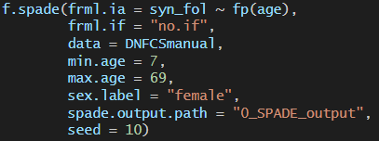
Exercise 1
Try to calculate the habitual intake distribution for syn_fol with a model that assumes daily intakes. Do you obtain a warning or an error?
Calculate the habitual potato intake for women 55 yr old (median, 25th and 75th percentile). use seed=10.

Slide 18
Answer exercise 1
Try to calculate the habitual intake distribution for syn_fol with a model that assumes daily intakes.

Slide 19
Answer exercise 1
Calculate the habitual potato intake for women 55 yr old (median, 25th and 75th percentile, use seed=10) ?
f.spade( frml.ia = potato ~ fp(age), # formula for intake amounts (ia) frml.if = potato ~ cs(age), # formula for intake frequencies (if) data = DNFCSmanual, min.age = 1, max.age = 79, age.classes = c(54,55), sex.label = "female", seed = 10, spade.output.path = "0_SPADE_output“)
spade output table for potato AM P5 P10 P25 P50 P75 P90 P95 ... (54,55] 64 22 29 42 59 81 106 120

Slide 20
Everyone potential consumer?
Manual paragraph 5.3
source: https://en.wikipedia.org/wiki/Beta_distribution
Remember, so far we assumed that the intake frequency follows a Beta distribution.
→ This is a smooth distribution
However, this assumption might not be correct: in quite some cases, there will be a spike of never-consumers!
Examples:
Vegetarians : meat consumption
Teetotalers : alcohol intake
Allergic patients : peanut consumption

Slide 21
How to account for never consumers?
Can not be calculated from repeated 24-hr recall
Need additional information from subjects with 24-hr recall data
e.g. additional (food frequency) questionnaire
Our experience: always check whether the answers to the additional questionnaire are consistent with the 24-hr recall data…
Sometimes these data do not match e.g. vegetarian eating meat (wrong linking of data or a little fibber (NL: jokkebrok))

Slide 22
Example from Dutch National Food Consumption Survey (2007-2010) alcohol

Slide 23
First CHECK YOUR DATA … always

Slide 24
DNFCS 2007-2010 Alcohol men 14-69 use FFQ info
Check the alcohol intakes for never-consumers (FFQ) in 24-hr recall
id age alcohol
1 1574 64 0.09
2 1574 64 0.09
3 690 55 0.11
4 99 32 0.13
5 697 16 0.16
6 180 68 0.16
7 1019 17 0.17
8 1027 18 0.17
9 467 39 0.19
10 1204 68 0.20
11 1365 23 0.20
12 431 44 0.20
13 239 16 0.23
14 776 15 0.23
15 1003 25 0.23
16 164 59 0.28
17 261 66 0.33
18 315 53 0.45
19 1663 15 0.64
20 1411 29 0.68
21 687 59 0.75
22 110 22 1.00
id age alcohol
23 409 15 1.46
24 409 15 1.46
25 1059 15 1.46
26 630 25 5.54
27 195 60 8.25
28 1217 68 9.28
29 1839 22 9.28
30 1411 29 9.43
31 616 30 9.53
32 282 54 10.73
33 22 51 11.05
34 623 18 11.39
35 22 51 12.33
36 816 54 12.33
37 128 40 12.58
38 113 61 12.83
39 872 18 13.26
40 1310 44 13.26
41 1358 21 13.26
42 1489 45 13.26
43 1126 46 14.03
44 626 38 14.50
id age alcohol
45 266 34 14.58
46 1136 53 15.42
47 816 54 18.86
48 282 54 20.00
49 572 63 22.09
50 572 63 22.09
51 295 53 23.49
52 264 62 25.70
53 979 22 26.51
54 1385 52 26.51
55 675 59 35.19
56 1888 56 35.89
57 70 62 39.77
58 1133 57 40.00
59 1316 51 40.00
60 542 22 43.31
61 1014 49 44.19
62 1112 40 47.14
63 675 59 52.01
64 1133 57 61.66
65 542 22 74.24
66 219 34 107.27
Many had a (small) intake of alcohol according to 24-hr recalls

Slide 25
SPADE function for food intake with neverconsumers: f.spade.neversconsumers

Slide 26
f.spade.neverconsumers -- special arguments:
neveruser.name =
column/variable with the information on never-consumers
neveruser.index =
value indicating the never consumers in neveruser.name (e.g. 1)
correct.neverusers =
What SPADE should do if there are never-users with positive intakes
0 = stop if there are never-users with one or more positive intakes (DEFAULT)
1 = correct the neveruser.index
2 = correct the positive observations

Slide 27
f.spade.neverconsumers – how does it work?

Slide 28
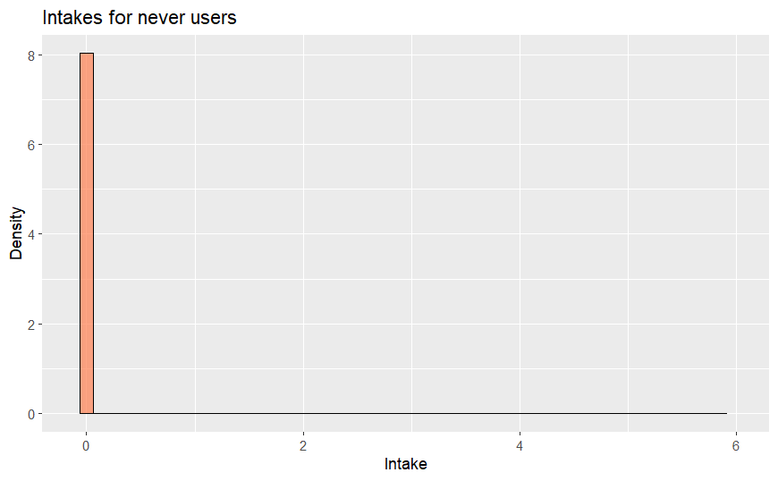
f.spade.neverconsumers – how does it work?
Modelling steps:
For every age: determine percentage of never-users.
HI distr. never-users
e.g. 25%

Slide 29
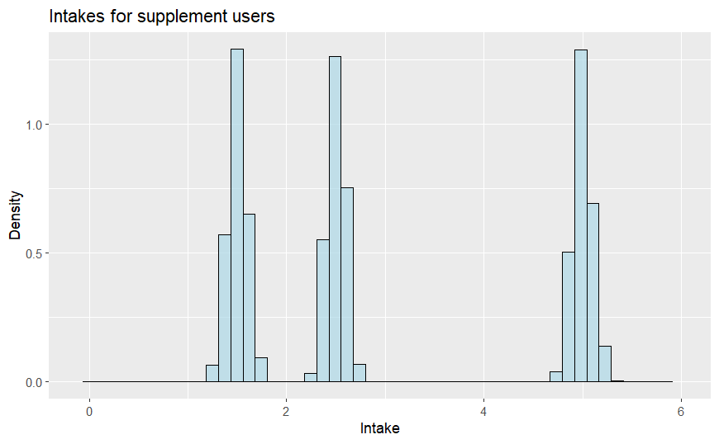
f.spade.neverconsumers – how does it work?
HI distr. never-users
Modelling steps:
For every age: determine percentage of never-users.
25% of population
Obtain HI distribution of ever-users.
HI distr. ever-users

Slide 30
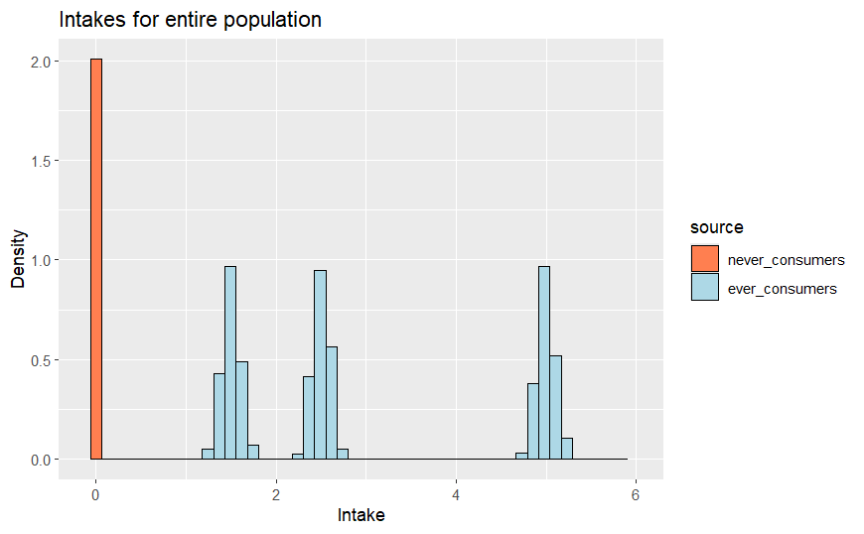
f.spade.neverconsumers – how does it work?
HI distr. never-users
Modelling steps:
For every age: determine percentage of never-users.
25% of population
Obtain HI distribution of ever-users.
For every age: combine the two distributions.
HI distr. ever-users
HI distr. entire population
75% of population

